Slide 1


Project Definition and Achievements
Project Goal: To address the challenge of "Data Scarcity" for broken screens in industrial production lines by using Generative AI to create realistic synthetic datasets for training Quality Assurance models.
Achievements:
Developed a fully automated four-stage pipeline: Base Generation, Smart Labeling/Masking, Defect Injection, and Perspective Rectification.
Scale of Success: Generated a robust dataset of 7,200 high-resolution images to train a high-accuracy classification model.
Successfully generated and classified five distinct classes: Good, Spiderweb, Scratch, Shattered Corner, and Puncture.
Successfully classified five distinct classes with 99.03% Top-1 accuracy.
Novelty: The project introduces a comparative analysis between models trained on Raw vs. Rectified images. By isolating and "flattening" the screen, we significantly improved training efficiency without sacrificing performance.

Slide 2
Data Preparation and Quality Efforts
Dataset Composition: To ensure a balanced and comprehensive training set, we generated:
3,600 Base Images: Clean, "Good" condition TV screens in varied industrial settings.
3,600 Defected Images: Created by applying inpainting to the base images, resulting in 900 images for each of the four defect categories
Synthetic Generation: Used SDXL Lightning to generate high-quality base images of TVs in industrial environments.
Precision Masking: Combined OWLv2 for object detection and SAM for segmentation
The identified screen area was slightly shrunk from the edges to prevent synthetic defects from overlapping with the TV's frame. Additionally, we automatically trimmed the bottom 10% of the detection box to ensure the TV stand was excluded from the mask, keeping the focus strictly on the display surface.
Perspective Rectification: Developed a preprocessing script using OpenCV to identify screen corners and apply a perspective transformation, creating a standardized, "flat" view for the classifier.
Prompt Engineering: Utilized extensive negative prompting to ensure baseline screens were "clean" and suitable.

Slide 3
Model Benchmarking: Evaluated four different models for generation and inpainting. We ultimately selected RealVisXL V4.0 Lightning for base generation and OzzyGT/RealVisXL_V4.0_inpainting for synthesis.
Iterative Testing:
Fine-Tuning: Attempted to use Dreambooth to fine-tune a model on defect data, but the results did not meet quality standards.
Localized Inpainting: Tested inpainting in small, specific areas, which created unnatural artifacts and "bad" visual transitions.
The Solution: These trials led to our successful full-screen masking approach which provided the most realistic and stable results for training

Slide 4
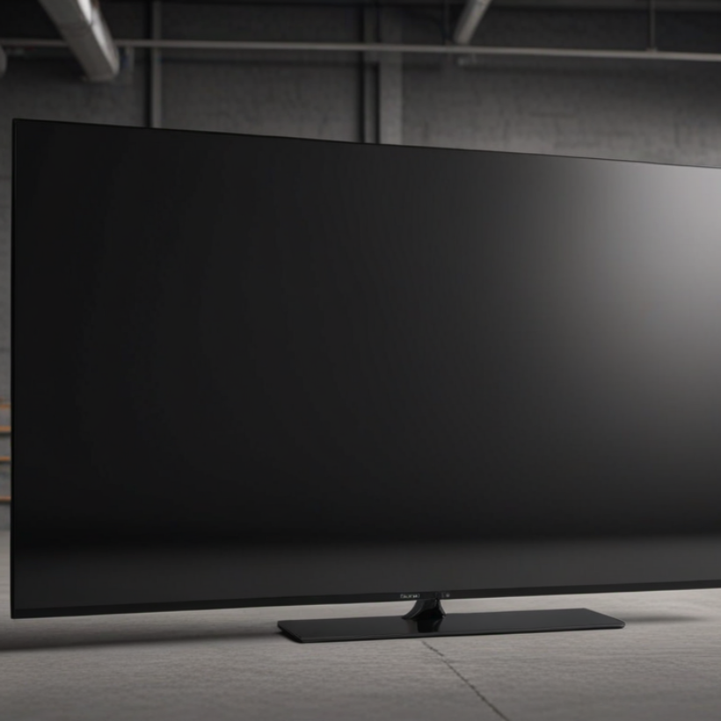
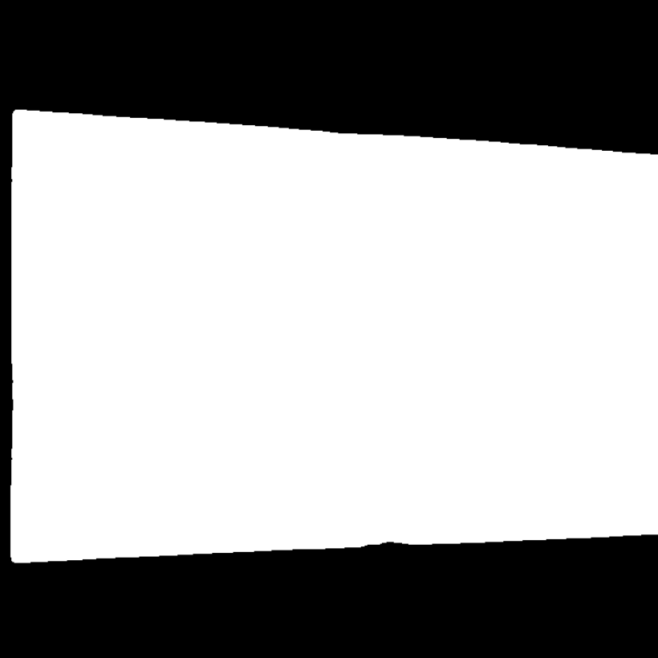
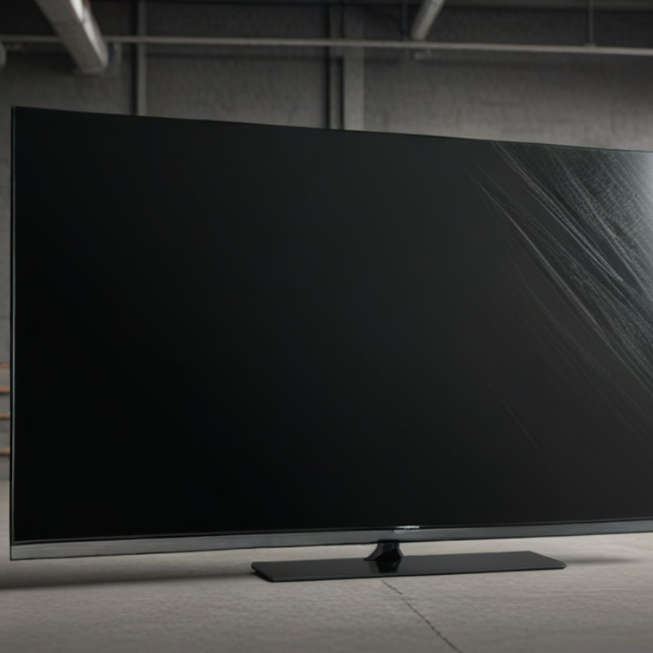

Example of the pipeline
The Good
The Mask
The Bad
The Ugly

Slide 5
Methodology and Results (Comparative Analysis)
#The core of our review is the comparison between the Raw Dataset (with backgrounds) and the Rectified Dataset (isolated screens).
Metric
Raw Dataset
Rectified Dataset
Top-1 Accuracy
99.09%
99.03%
Training Time (10 Epochs)
2318.97 s
1308.96 s
Best Accuracy Epoch
10
7
Validation Loss
0.0293
0.0346
Key Insight: The Rectification step proved critical, reducing training time by approximately 43% while maintaining comparable accuracy

Slide 6
Conclusions and Future Directions
Desired Results: Yes, the pipeline achieved near-perfect accuracy (99%+) and established that isolating the Region of Interest via rectification makes for a much more efficient model training.
Lessons Learned:
Standardizing the input via perspective transformation allows the model to converge faster and focus purely on defect textures rather than varying camera angles.
Generative AI can effectively bridge the "Data Scarcity" gap for rare industrial defects.
Future Ideas:
Synthetic-to-Real Validation: Testing the model on a small sample of actual broken TVs to measure real-world generalization.
Real-Time Factory Integration: Adapting the perspective rectification pipeline for live video processing; by isolating the screen area, we reduce computational load to allow higher FPS, enabling instantaneous quality feedback on high-speed industrial conveyor belts.

